Slide 1

M.V.P SAMAJ’S
A Presentation on
“A Comparative Study of Private and Public Sector Banks Share Price”
K.R.T.Arts, B.H. Commerce & A.M. Science College, Nashik
Submitted By
Archana Ramkrishna Sangle
Omkar Mahesh Aher
Shweta Sanjay Jadhav
Under the Guidance of,
Mr. D. B. Uphade
(2021-2022)

Slide 2
Content
Introduction
Objectives
Methods
ARIMA: Autoregressive Integrated Moving Average
ARIMA Model Results
LSTM: Long Short-Term Memory
LSTM Model
Result
Conclusions
Limitations
Future Implementation
References

Slide 3


INTRODUCTION
Predicting stock market is one of the most difficult tasks in the field of computation. There are many factors involved in the prediction – physical factors vs. physiological, rational and irrational behaviour, investor sentiment, market rumours, etc. All these aspects combine to make stock prices volatile and very difficult to predict with a high degree of accuracy.
In this project, we have performed time series analysis with the help of a Autoregressive Integrated Moving Average (ARIMA), Long Short-Term Memory(LSTM) networks. We have predicted the future stock prices of the private sector banks and public sector banks, based on its stock prices of the past 5 years

Slide 4
OBJECTIVES
To predict the stock prices of private and public sector banks using ARIMA and LSTM model.
To predict the stock prices of private and public sector banks using ARIMA and LSTM model.
To check whether ARIMA and LSTM model are best for stock price prediction using short time or long time historical data.

Slide 5

DATA Description
Open is the price at which a stock began in a given time period
Close is the price at which a stock closed in a given time period
High is the maximum price in a given time period
Low is the minimum price in a given time period
Adjusted closing price amends a stock's closing price to reflect that stock's value after accounting for any corporate actions.
Volume is the number of shares of a security traded during a given period of time.

Slide 6
Date | Open | High | Low | Close | Adjusted Close | Volume
01-06-2017 | 819.5 | 819.924988 | 810.275024 | 814.299988 | 784.495972 | 1679770
02-06-2017 | 817 | 823.049988 | 813.099976 | 817.125 | 787.2159 | 1606772
05-06-2017 | 816.849976 | 819.474976 | 812.5 | 817.775024 | 787.843811 | 1449950
06-06-2017 | 817.5 | 821.900024 | 815 | 819.474976 | 789.481628 | 2501316
07-06-2017 | 820.200012 | 822.450012 | 815.174988 | 820.400024 | 790.372864 | 1277138
08-06-2017 | 821.950012 | 829.700012 | 820.825012 | 822.375 | 792.275452 | 2124384
09-06-2017 | 820.049988 | 835 | 820.049988 | 833.400024 | 802.896973 | 2652636
12-06-2017 | 832 | 838 | 830 | 834.375 | 803.836304 | 1985706
13-06-2017 | 830.875 | 845.950012 | 830.5 | 838.349976 | 807.665649 | 2525810
14-06-2017 | 837.5 | 839.974976 | 833.5 | 835.599976 | 805.016357 | 1929180
15-06-2017 | 834 | 837.799988 | 826.799988 | 832.174988 | 801.716736 | 1763346
16-06-2017 | 832.5 | 837.349976 | 829.049988 | 834.625 | 804.077087 | 1877552
19-06-2017 | 835.5 | 848 | 834.200012 | 846.450012 | 815.46936 | 1912766
20-06-2017 | 845 | 847 | 839.924988 | 843.275024 | 812.410522 | 1830132
21-06-2017 | 841.2999988 | 850.625 | 839.799988 | 849.349976 | 818.263123 | 1705466
22-06-2017 | 847.474976 | 858 | 845.599976 | 849 | 817.926025 | 3337730
23-06-2017 | 851 | 851.375 | 837.599976 | 839.325012 | 808.605103 | 2608734
27-06-2017 | 844.5 | 847.5 | 828.125 | 833.825012 | 803.306396 | 3000216
28-06-2017 | 832.5 | 837.5 | 828.900024 | 833.224976 | 802.728271 | 2224518
29-06-2017 | 833.5 | 840.980012 | 825.549988 | 831.525024 | 806.413574 | 4593854

Slide 7
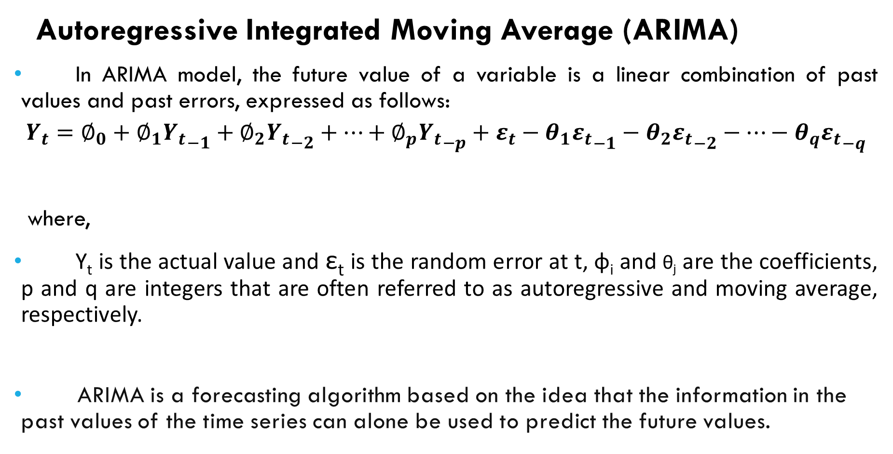
Autoregressive Integrated Moving Average (ARIMA)
In ARIMA model, the future value of a variable is a linear combination of past values and past errors, expressed as follows:
$$Y_{t}­=∅_{0}­+∅_{1}{Y_{t}}_{−1}­­+∅_{2}{Y_{t}}_{−2}+…+∅_{p}{Y_{t}}_{−p}­+ε_{t}­−θ_{1}ε_{t}­_{−1}­−θ_{2}ε_{t}­_{−2}−…−θ_{q}ε_{t}­_{−q}$$
where,
Y_{t} is the actual value and ε_{t} is the random error at t, φ_{i} and θ_{j} are the coefficients, p and q are integers that are often referred to as autoregressive and moving average, respectively.
ARIMA is a forecasting algorithm based on the idea that the information in the past values of the time series can alone be used to predict the future values.

Slide 8
Box-Jenkins methodology:
Step 1: Data Preparation
Step 2: Model Selection
Step 3: Estimation and Testing
Step 4: Diagnostic
Step 5: Forecast the application

Slide 9
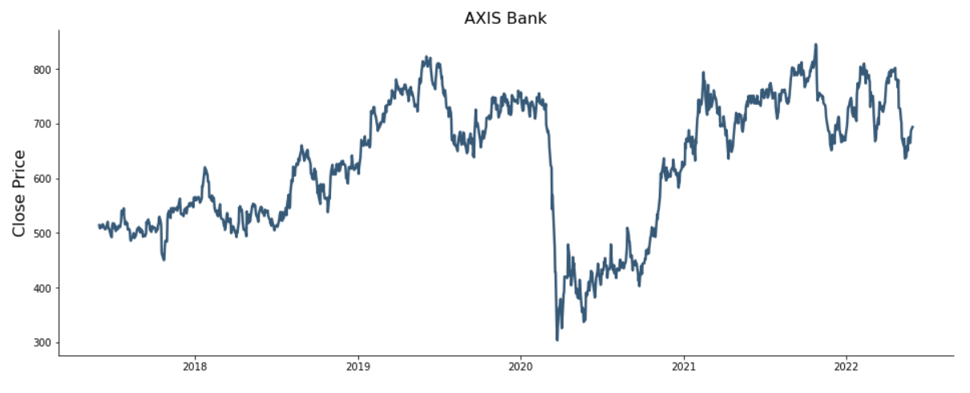
Visualization
Closing price of Axis Bank

Slide 10
ARIMA MODEL RESULTS
Model | ARIMAX(0,1,0)
Sample | 0-1046
No. Observation | 1046
Log Likelihood | 2351.263
AIC | -4700.525
BIC | -4695.573
HQIC | -4698.647
Ljung-Box | 0.38
Prob(Q) | 0.54
Heteroskedasticity | 2.47
Jarque-Bera (JB) | 460674.38
Prob(JB) | 0.00
Skew | -1.71
Kurtosis | 33.37
Prob(H)(two sided) | 0.00
Covariance Type | opg

Slide 11
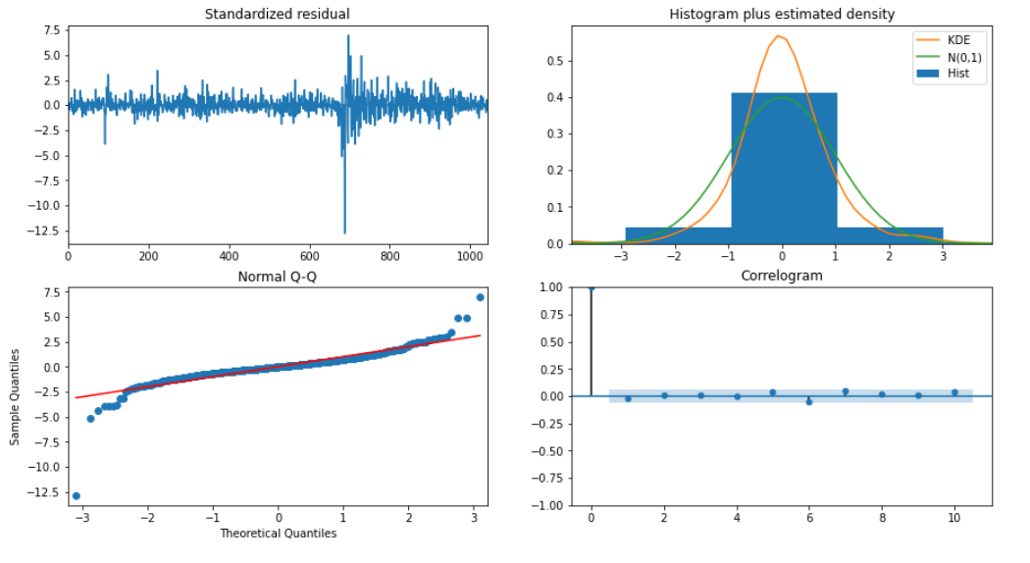
Interpretation:
The residual errors seem to fluctuate around a mean of zero and have a uniform variance.
The density plot suggest normal distribution with mean zero.
All the points are fall perfectly in line with the red line.
The Correlogram plot shows the residual errors are not autocorrelated.

Slide 12
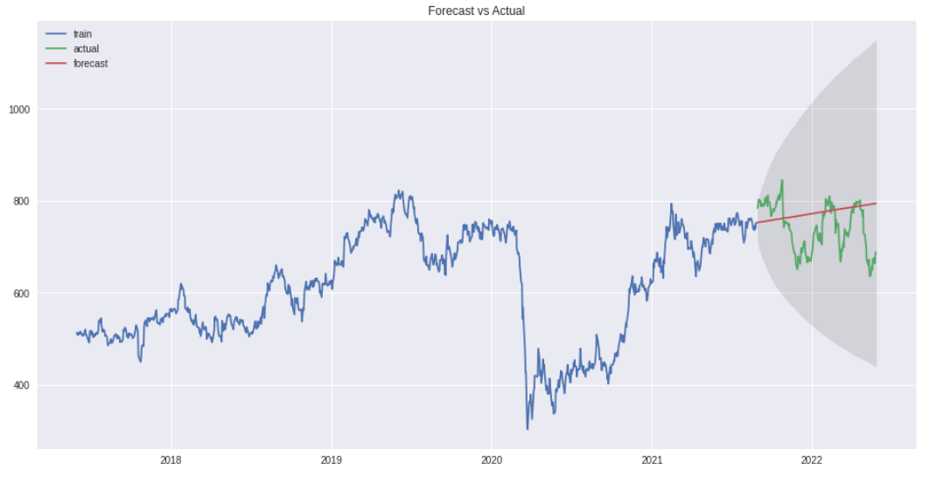
ARIMA Graph result:
From the
Interpretation:
Actual values are well within the Upper and Lower range but predicted values form a straight line. So, ARIMA model is not performs well for forecasting.

Slide 13
ACTUAL PRICE VS PREDICTED PRICE
Date | Actual price | Predicted price
2022-05-02 | 727.349976 | 790.381375
2022-05-04 | 707.200012 | 790.608808
2022-05-05 | 702.349976 | 790.836242
2022-05-06 | 673.400024 | 791.063675
2022-05-09 | 663.700012 | 791.291108
2022-05-10 | 659.750000 | 791.518541
2022-05-11 | 649.650024 | 791.745975
2022-05-12 | 649.650024 | 791.973408
2022-05-13 | 635.950012 | 792.200841
2022-05-16 | 638.950012 | 792.428274
2022-05-17 | 654.950012 | 792.655708
2022-05-18 | 659.450012 | 792.883141
2022-05-19 | 650.200012 | 793.110574
2022-05-20 | 673.099976 | 793.338007
2022-05-23 | 675.349976 | 793.565441
2022-05-24 | 664.049988 | 793.792874
2022-05-25 | 665.000000 | 794.020307
2022-05-26 | 683.250000 | 794.247740
2022-05-27 | 688.299988 | 794.475173

Slide 14
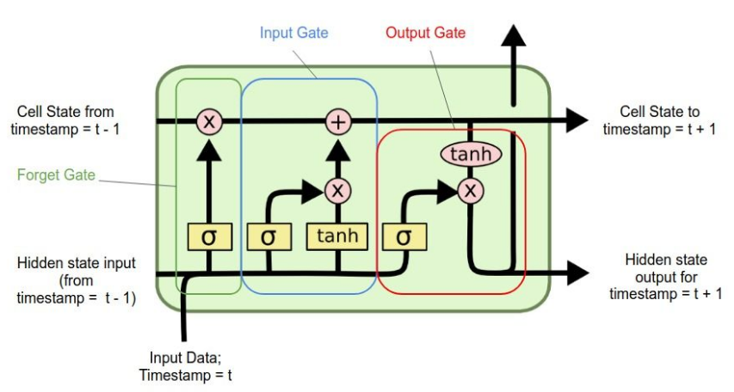
Long Short Term Memory (LSTM)
Long-Short-Term Memory(LSTM) models are a type of Recurrent Neural Networks(RNNs) which has the ability to learn and remember over long sequences of input data through the use of “gates” which regulate the information flow of the network.
LSTM is used for processing, predicting, and classifying on the basis of time-series data.

Slide 15
LSTM model Algorithm
Step 1: Raw Stock Price Dataset
Step 2: Pre-processing
a) Data transformation
b) Data cleaning
c) Data integration
Step3: Feature Selection
Step 4: Train the NN model
Step 5: Output Generation
Step 6: Test Dataset Update
Step 7: Error calculation
Step 8: Visualization

Slide 16
ACTUAL PRICE VS PREDICTED PRICE
Date | Actual price | Predicted price
2022-05-02 | 727.349976 | 733.413391
2022-05-04 | 707.200012 | 726.785767
2022-05-05 | 702.349976 | 709.560669
2022-05-06 | 673.400024 | 702.579895
2022-05-09 | 663.700012 | 675.489197
2022-05-10 | 659.750000 | 662.044006
2022-05-11 | 672.349976 | 656.410828
2022-05-12 | 649.650024 | 666.792053
2022-05-13 | 635.950012 | 646.296814
2022-05-16 | 638.950012 | 629.534180
2022-05-17 | 654.950012 | 630.558105
2022-05-18 | 659.450012 | 646.523132
2022-05-19 | 650.200012 | 653.010986
2022-05-20 | 673.099976 | 645.018127
2022-05-23 | 675.349976 | 666.253174
2022-05-24 | 664.049988 | 671.745117
2022-05-25 | 665.000000 | 661.934326
2022-05-26 | 683.250000 | 662.550110
2022-05-27 | 688.299988 | 680.676392
2022-05-30 | 693.650024 | 687.768127

Slide 17
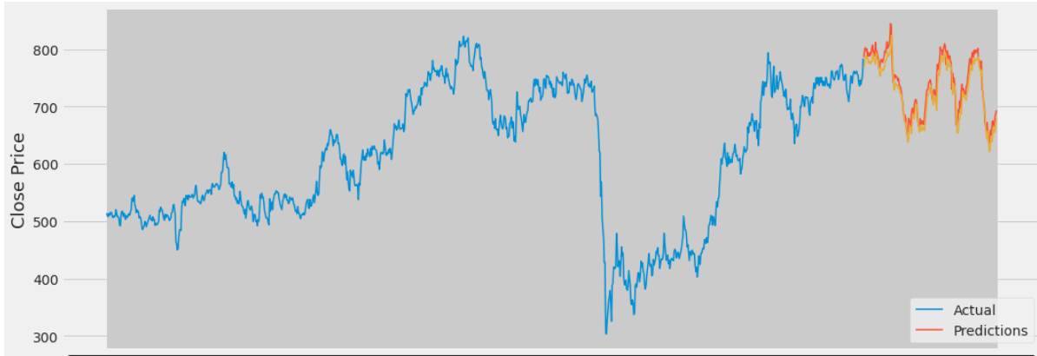
LSTM Graph results
Interpretation:
From the graph we can say that Predicted values are very much similar to actual values.

Slide 18
Comparison of Models for Private sector banks:
HDFC | LSTM Model | ARIMA Model
Mean absolute error | 18.2903782004223 | 135.4230901560626
Root mean squared error | 25.5654726155 | 171.5922575869928
Mean absolute percentage error | 0.012449832046453 | 0.09511067852359
AXIS | LSTM Model | ARIMA Model
Mean absolute error | 10.65835117978696 | 52.7634035162395
Root mean squared error | 14.15507827603499 | 64.2629208167192
Mean absolute percentage error | 0.014743557328145 | 0.07328503428783
ICICI | LSTM Model | ARIMA Model
Mean absolute error | 13.7642541232911 | 35.4417446344637
Root mean squared error | 17.5636479804906 | 45.5898196306352
Mean absolute percentage error | 0.02099356990267 | 0.05114328982555
Interpretation:
From the above table we can say that LSTM model outperforms ARIMA model for Private sector banks.

Slide 19
Comparison of Models for Public sector banks:
SBI | LSTM Model | ARIMA Model
Mean absolute error | 7.274802945818950 | 63.0252011401502
Root mean squared error | 9.252523976495713 | 69.8001774174519
Mean absolute percentage error | 0.016195267853558 | 0.12564847481025
PNB | LSTM Model | ARIMA Model
Mean absolute error | 0.820167926461396 | 11.55590804723108
Root mean squared error | 1.224801744913640 | 12.83620375735154
Mean absolute percentage error | 0.022942275610086 | 0.22978097562763
BARODA | LSTM Model | ARIMA Model
Mean absolute error | 1.901777280657167 | 31.271031850503563
Root mean squared error | 2.505278174552066 | 35.39502699352652
Mean absolute percentage error | 0.020615808962723 | 0.0302862973016498
Interpretation:
From the above table we can say that LSTM model outperforms ARIMA model for Public sector banks.

Slide 20
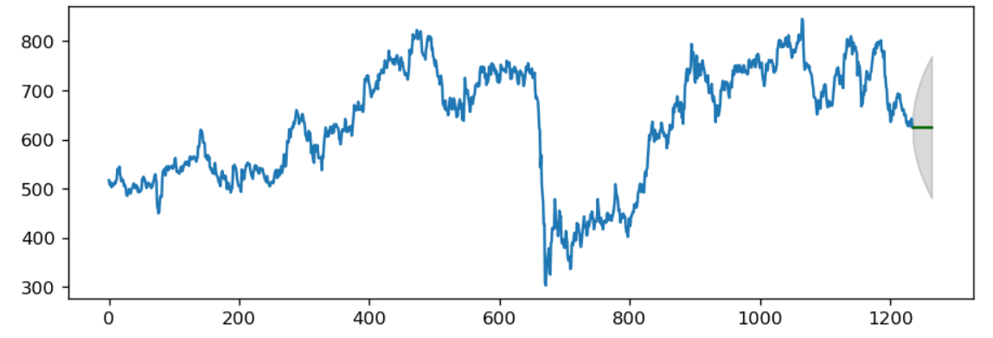
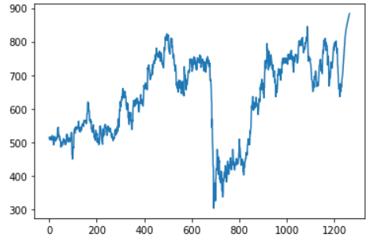
Forecasted graph of ARIMA Forecasted graph of LSTM
Interpretation:
ARIMA model gives a linear graph while LSTM gives a increasing trend.

Slide 21
Date | Forecasted Price
2022-30-06 | 634.48639464
2022-01-06 | 634.48639464
2022-04-06 | 633.93973543
2022-05-06 | 634.46071396
2022-06-07 | 634.46071396
2022-07-07 | 636.4704933
2022-08-07 | 637.95128303
2022-11-07 | 639.74867187
2022-12-07 | 641.85199993
2022-13-07 | 644.24288695
2022-14-07 | 646.8974612
2022-15-07 | 649.78849148
2022-18-07 | 652.88700224
2022-19-07 | 656.16401791
2022-20-07 | 659.59143513
2022-21-07 | 663.14276564
2022-22-07 | 666.79404082
2022-25-07 | 670.5232625
2022-26-07 | 674.31130746
2022-27-07 | 678.14105525
2022-28-07 | 681.99761432
2022-29-07 | 685.86761132
2022-01-08 | 689.73919116
2022-02-08 | 693.60146781
2022-03-08 | 697.44426591
Next 25 days forecast:

Slide 22
We perform LSTM model for different time interval:
Bank Name | 6 month | 1 year | 3 year | 5 year
HDFC | 100.34726573 | 43.59998799 | 29.498581118 | 28.753056665
AXIS | 19.173693145 | 15.17525243 | 13.255365514 | 14.4133976644
ICICI | 17.476687173 | 13.27412165 | 26.853896977 | 12.6594478040
Avg error | 45.6658 | 24.0148 | 23.2023 | 18.6077
Bank Name | 6 month | 1 year | 3 year | 5 year
SBI | 17.10925646 | 20.979282847 | 12.281129625 | 11.660056047
PNB | 2.6642830446 | 2.4152469758 | 1.2509023957 | 1.0238603172
Baroda | 5.385010101 | 8.715423288 | 2.516242643 | 2.5052781747
Avg error | 8.3861 | 10.7032 | 5.3494 | 5.063
Interpretation:
It has been observed from the result that for almost all the banks the error level comes down drastically with the test data for longer periods. So LSTM model is best for to predict the share price on long time historical data.

Slide 23
We perform ARIMA model for different time interval:
Bank Name | 6 month | 1 year | 3 year | 5 year
HDFC | 38.150583481379 | 33.614959735605 | 107.41865972195 | 171.592257586
AXIS | 19.404355982462 | 101.76303106889 | 73.748771396376 | 52.7634035162
ICICI | 18.784572207323 | 39.301218085962 | 42.143636019551 | 35.441744634
Avg error | 25.4465063 | 58.225495 | 74.43792 | 86.5991
Bank Name | 6 month | 1 year | 3 year | 5 year
SBI | 19.552493057286 | 36.40256431812 | 36.40256431812 | 69.80017741745
PNB | 3.1187281682456 | 3.623841656841 | 4.878025681776 | 11.55590804723
Baroda | 5.0797281303600 | 12.63244485337 | 8.34375576668 | 35.39502699352
Avg error | 9.25016 | 17.55294 | 16.57252 | 38.91809
Interpretation:
It has been observed from the result that for almost all the banks the error level comes down drastically with the test data for shorter periods. So ARIMA model is best for to predict the share price on short time historical data.

Slide 24
CONCLUSIONS:
ARIMA model is best for to predict the share price on short time historical data and LSTM model is best for to predict the share price on long time historical data.
In this project, we study the use of ARIMA model and LSTM model to predict share prices of private and public sector banks. Among these algorithms, we concluded that LSTM model gave us better results. LSTM is a promising type of tool for financial forecasting.

Slide 25
Future Implementation:
LIMITATIONS:
The LSTM model is fitted for the bank sector data only. So we cannot generalize this in case of all other sectors.
Stock Data not only depends on the Trend in the Historical Data, it also mainly depends on the product value or the satisfaction of the customers with the company’s market. So, the future implementation includes analysing the sentiment of the customers reviewed on the products related to a company or its domain and add this analysis to the prediction using LSTM.

Slide 26
REFERENCES:
Devi, B. U., Sundar, D., & Alli, P. (2013). An effective time series analysis for stock trend prediction using ARIMA model for nifty midcap-50. International Journal of Data Mining & Knowledge Management Process, 3(1), 65.
Ariyo, A. A., Adewumi, A. O., & Ayo, C. K. (2014, March). Stock price prediction using the ARIMA model. In 2014 UKSim-AMSS 16th international conference on computer modelling and simulation (pp. 106-112). IEEE.
Ghosh, A., Bose, S., Maji, G., Debnath, N., & Sen, S. (2019, September). Stock price prediction using LSTM on Indian Share Market. In Proceedings of 32nd international conference on (Vol. 63, pp. 101-110).
Vijh, M., Chandola, D., Tikkiwal, V. A., & Kumar, A. (2020). Stock closing price prediction using machine learning techniques. Procedia computer science, 167, 599-606.

Slide 27

THANK YOU

